Slide 1

Mail Box
OSED Review 4
MURARU G 01FE20BEC102
ANAND D 01FE20BEC102
NITISH K 01FE20BEC111
D S SANJAYA 01FE20BEC115
Guide Teacher – Rohini Mam

Slide 2
Problem Statement
Mailbox – Write a C Program to demonstrate the concept of Mailbox.
Task 1. Post the switch status (SW1, SW2) to Mailbox.
Task 2. Take the data from mailbox and control the stepper motor (clockwise, anticlockwise , pause and stop)

Slide 3
Understanding The Concepts
A mailbox is a special memory location that one or more tasks can use to transfer data

Slide 4
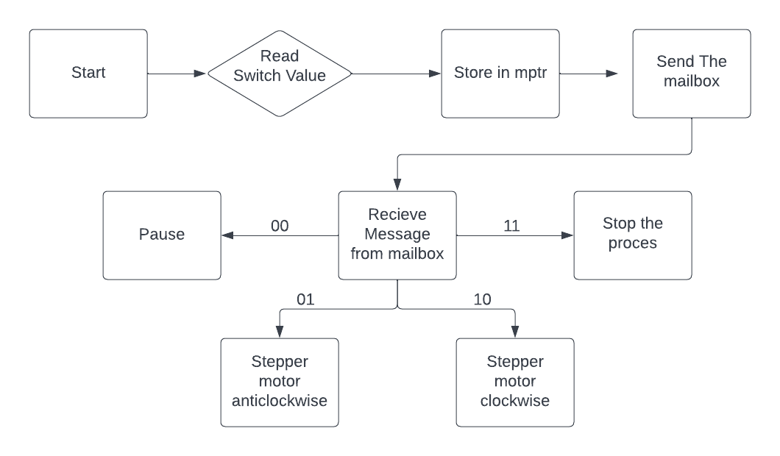
Work Flow

Slide 5
Thank You

